Slide 1

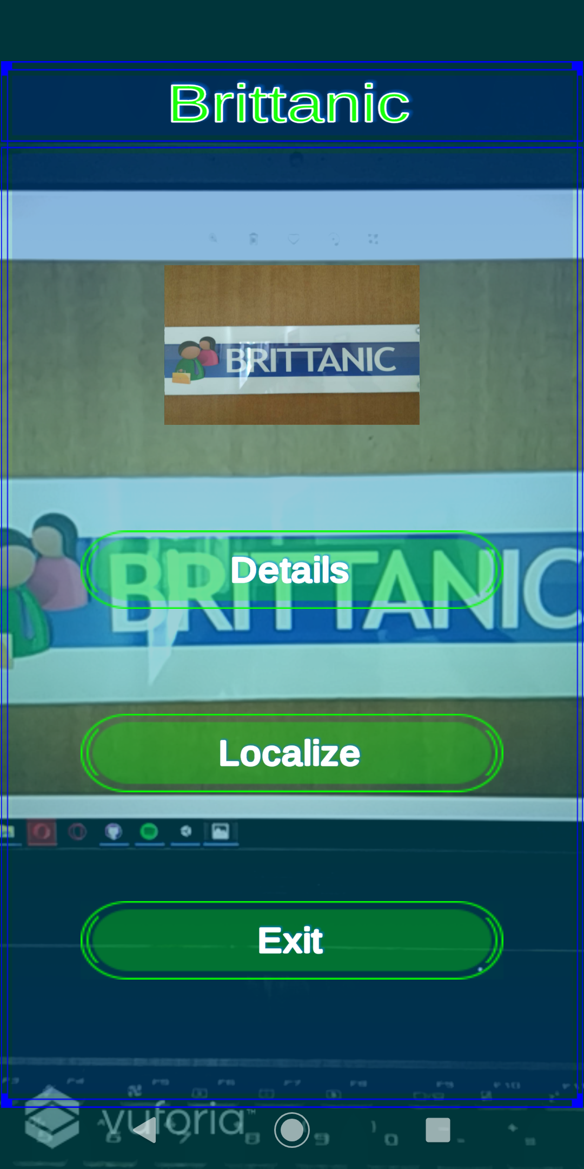
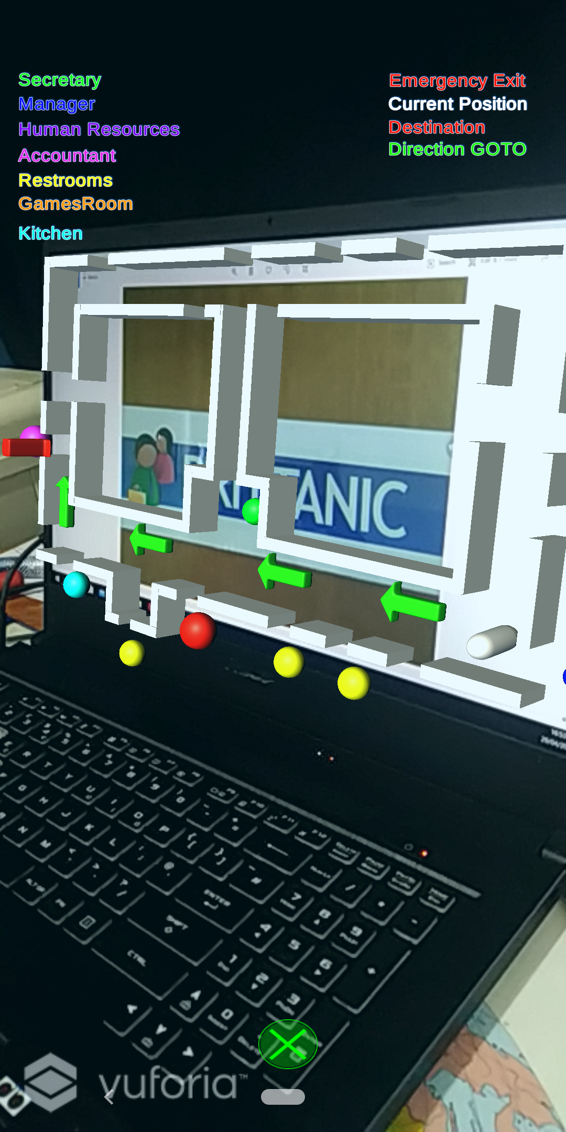
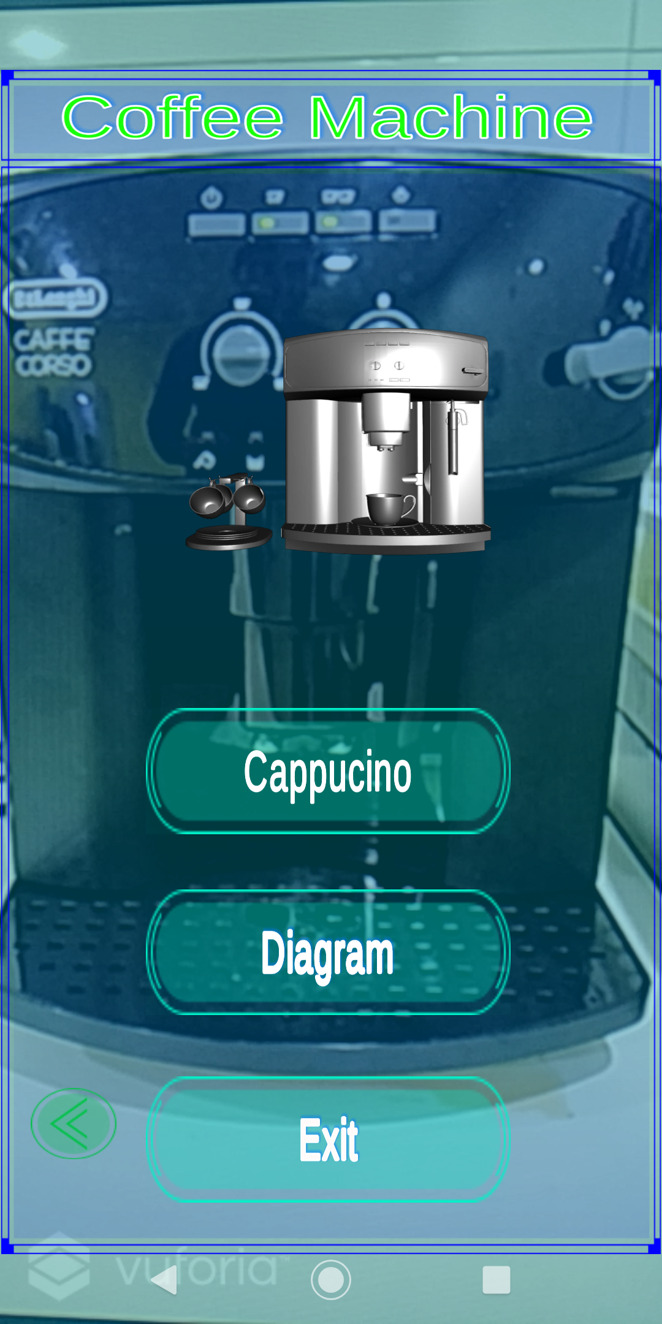
B.Sc. IT (Hons.)
Artificial Intelligence
Workplace Assistant Augmented Reality (WAAR)
Gabriel Camilleri
Supervisor: Dr. Vanessa Camilleri
INTRODUCTION
Starting a new job in an oﬃce can be very stressful for an intern or a new employee, especially on their ﬁrst day at the oﬃce. The ﬁrst month at the workplace might seem overwhelming for new employees. Therefore, during their ﬁrst few months of settling and adjusting, the company may allow “a period of learning how to ‘ﬁt in’ and adjusting to how things work in the new setting”[1] for the employee’s beneﬁt. Providing an assistant AR application to help speed up the process for the employee to adjust to their new workplace environment may oﬀer several challenges. However, such challenges may be overcome using a combination of A.I. techniques that may help in providing efficient image and object recognition, through a combination of deep learning and traditional computer vision as well as user profiling techniques for filtering information.
Marker Design and Output
AIM
The aim of this project is to combine user profiling techniques with image and object detection and present these in an Augmented Reality application designed for the workplace. The objectives are to perform image and object detection and to overlay information to provide assistance via AR, to perform user profiling through a recommendation based system using a combination of an SVD++[2], to model and to create an item to item based similarity for collaborative and similarity based filtering respectively, to filter out unnecessary information for augmentation, and finally to apply and evaluate the artificially intelligent techniques through quality and quantity testing.
Marker Recognition
3D Holographic Map
Coffee Machine Recognition
METHODOLOGY
User Interface and System Architecture Implementation
Feature Extraction
Data Handling
User-Query Modelling
RESULTS
The SVD++ model achieved average Root Mean Square Error and Mean Absolute Error of 3.1226 and 2.6866 respectively. In comparison to other baselines it has obtained the lowest RMSE and MAE values, hence making it the most efficient filtering model to apply. The AR application obtained on average a distance variance of 130 cm and 150 cm for image and model targets respectively, a 270 degrees of rotation variance for both targets, and an average occlusion variance of 0.55% and 0.64% for image and model targets respectively. The system obtained on average positive qualitative results via user-feedback along with recommendations on how it may be further improved.
CONCLUSIONS AND FUTURE WORK
This project has developed a recommendation-based system using a combination of SVD++ model and item-to-item based similarity for collaborative and similarity-based filtering, for an Augmented Reality Workplace Assistant. The application may be further improved by applying location based augmented reality to precisely augment information in specific locations. Explainable AI may help in interpreting the A.I. models applied which may help keep transparency with the users. Interactive AR may be further developed thus enabling the user to interact with real world object through the application. The results obtained are not surprising and are indeed promising for augmented reality to be applied to support and facilitate assistance in different workplace environments.
REFERENCES
[1] P. Moita, “Adjustment to the work place by new recruits in libraries,” vol. Vol.5(2), pp. 71–85, 04 2015. [2] F. Cacheda, V. Carneiro, D. Ferna´ndez, and V. Formoso, “Comparison of collaborative ﬁltering algorithms: Limitations of current techniques and proposals for scalable, high-performance recommender systems,” TWEB, vol. 5, p. 2, 01 2011. [3] G. Camilleri. Workplace assistant augmented reality. Youtube. [Online]. Available:https://www.youtube.com/watch?v=KnNCyWy6fkA

